Slide 1
Windows Development and .NET Overview
Objectives:
.NET & Windows Development
.NET Standard
C# Requirement for WPF Development

Slide 2
.NET & Windows Development

Slide 3
.NET
.NET is a free, cross-platform, open-source developer platform for building many different types of applications.
www.dot.net
Notes:
What is .NET
.NET is a free, cross-platform, open-source developer platform for building many different types of applications.
With .NET, you can use multiple languages, editors, and libraries to build for web, mobile, desktop, games, and IoT.

Slide 4
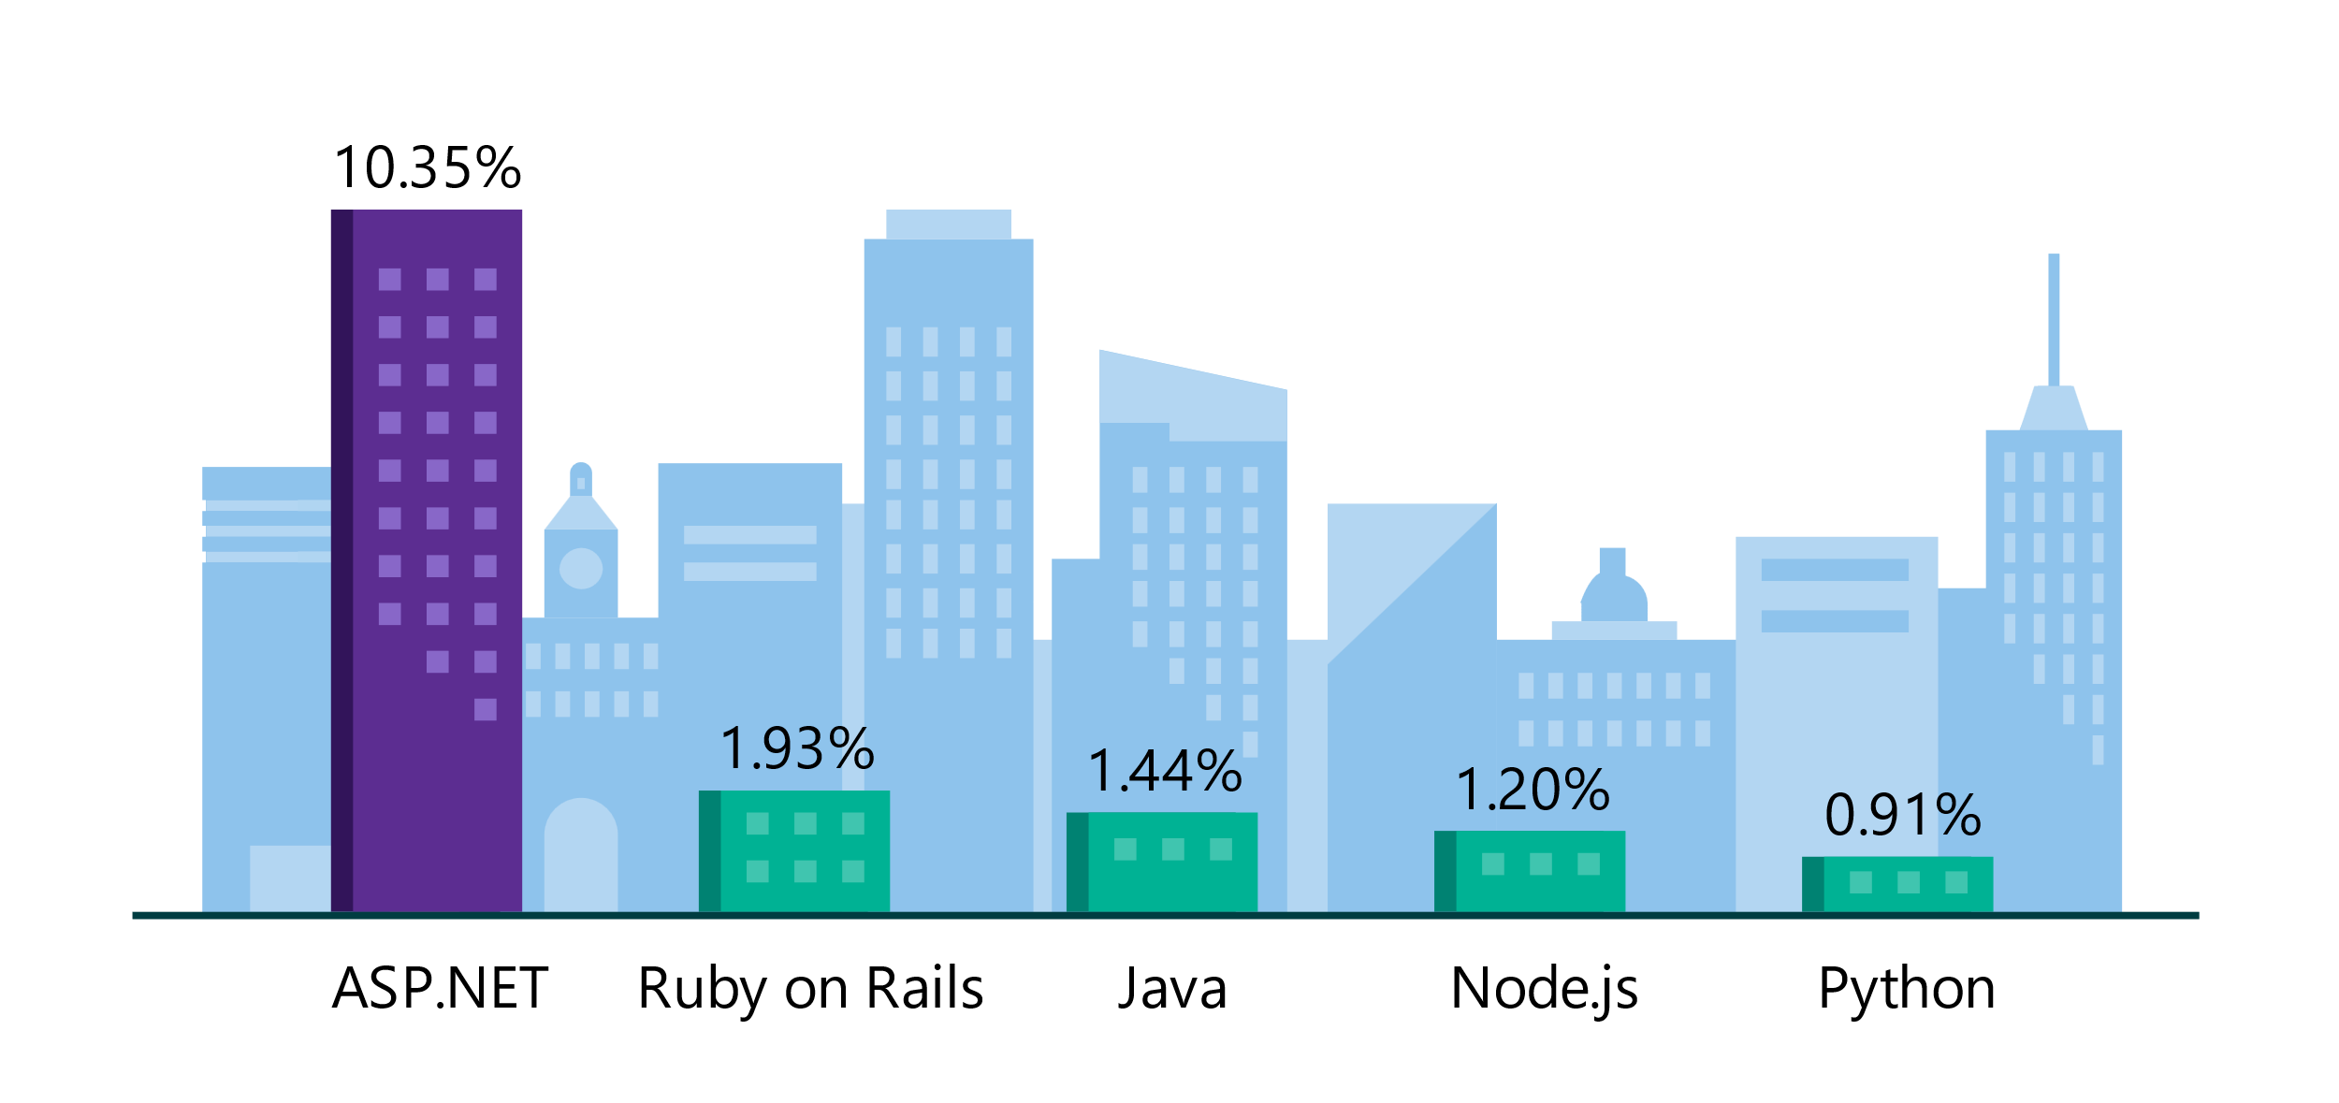
.NET is the platform of choice for the top 100K websites
More websites have been developed with ASP.NET than Ruby, Java, Python, Node.js, and Go combined.
Companies like Raygun, GoDaddy, and Tencent choose .NET for better performance, increased flexibility, and higher compatibility.
Data sourced from SimilarTech
Notes:
https://www.similartech.com/categories/framework
ASP.NET is the name of the web framework for .NET. As you can see there are more top websites developed with .NET than these other technologies. Only PHP has more.

Slide 5
.NET is Fast. Really Fast!
7.01M
2.17M
requests / sec
0.66M
requests / sec
requests / sec
Java Servlet
.NET
Node.js
Data sourced from official tests available at TechEmpower Round 20.
“Using the same-size server, we were able to go from 1,000 requests per second per node with Node.js to 20,000 requests per second with .NET Core.“ — Raygun
https://www.microsoft.com/net/customers
Notes:
.NET is fast. Really fast! That means applications provide better response times and require less compute power. StackOverflow serves 5.3M page views a day on just 9 servers!
The popular TechEmpower benchmark compares web application frameworks with tasks like JSON serialization, database access, and server side template rendering - .NET performs faster than any other popular framework.
https://www.techempower.com/benchmarks/#section=data-r14&hw=ph&test=plaintext
The community has played a crucial role in performance work for the .NET stack.
https://blogs.msdn.microsoft.com/dotnet/tag/performance/

Slide 6

.NET is Open Source
6,900+ contributors from outside of Microsoft
21,000+ community contributions for .NET 6 release
87% of contributors from outside of Microsoft
“Samsung is embracing .NET because it is a completely open source project.” — Samsung
".NET is open source; that allows us to contribute back to it if we have any performance issues which Microsoft review and together we make a better product.“ — Illyriad Games
Notes:
We’ve seen companies taking a bet on .NET because it’s a completely open source project. More than 16,000 contributors* from 3300 companies have contributed to .NET Core and related open source repositories, with over half of the contributions coming from outside Microsoft.
Samsung is a big partner and are releasing their new Smart TVs that support .NET. They plan to expand to all their IoT devices too. Illyriad Games, specifically Ben Adams, contributed many performance enhancements to the platform. They build a MMO with hundreds of thousands of concurrent users so performance is super important to them. These enhancements not only benefit them but everyone that uses .NET.
*contributor = Submitted a Pull Request or Created an Issue

Slide 7
What cross-platform means!?
You can create .NET apps for many operating systems, including:
Windows
macOS
Linux
Android
iOS
tvOS
watchOS
Supported processor architectures include:
x64
x86
ARM32
ARM64

Slide 8
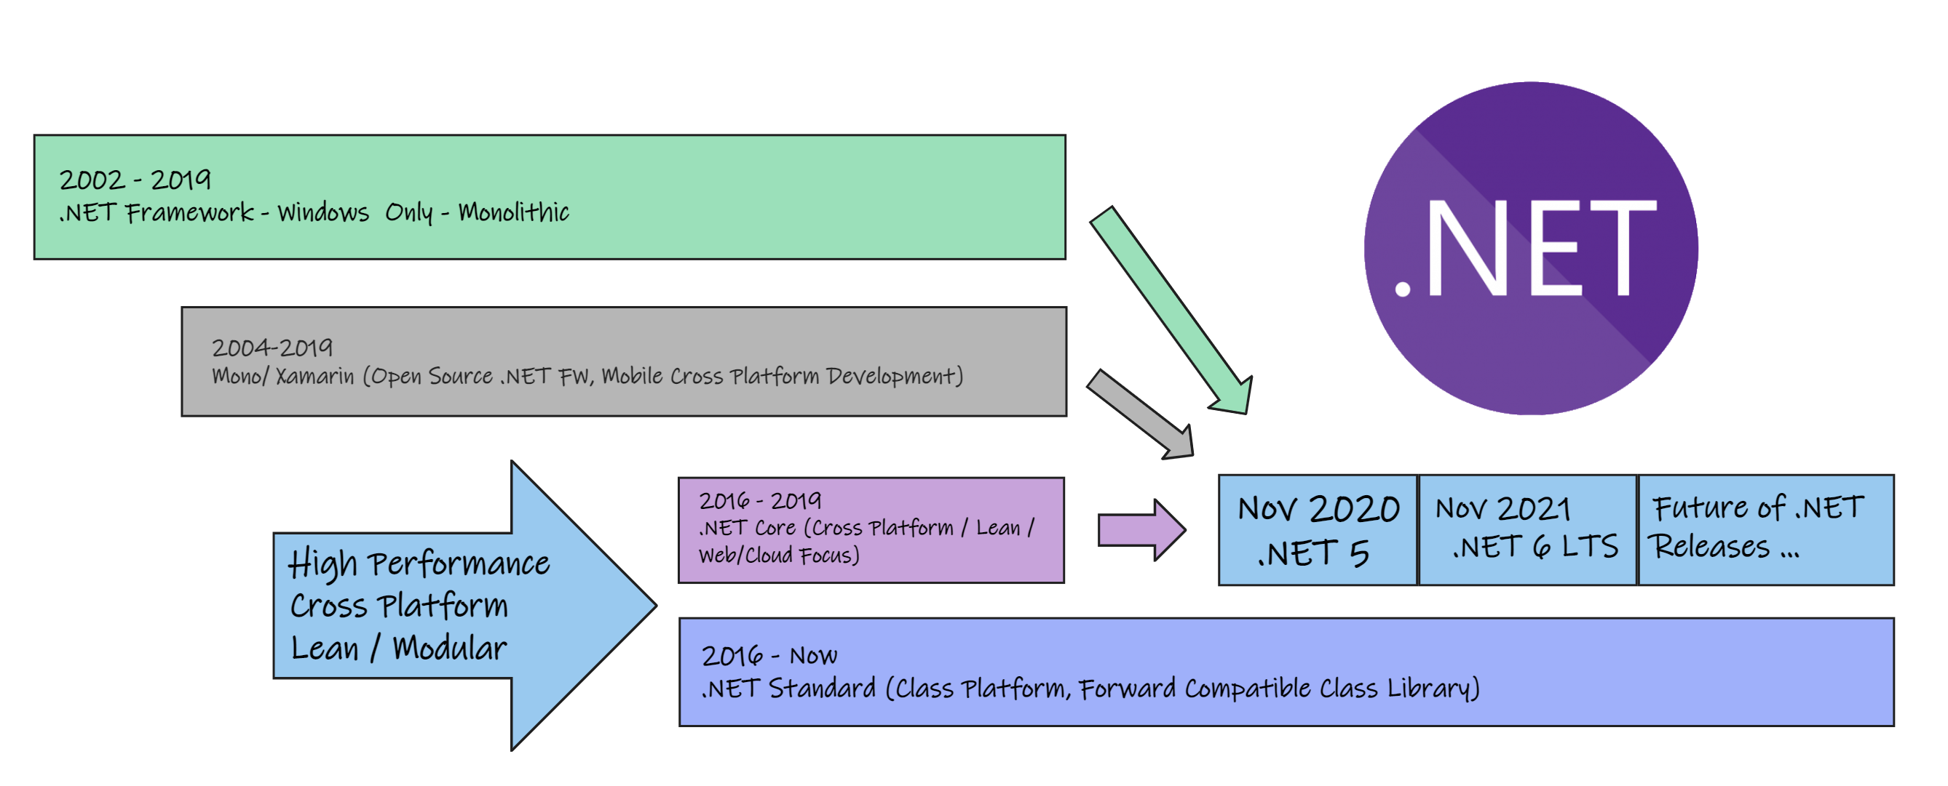
.NET – Unification story

Slide 9
.NET Framework vs .NET
 | Legacy .NET Framework (FX) | .NET (Core)
Versioning: | Single Version on host for all applications. | Multiple versions side by side, including bundling the version inside application make it VM independent
Platform: | Windows Only | Cross Platform
DevOps: | No Support for Containers (unless full version of windows containers used) | Support for Containers and Modern DevOps Scenarios
Architecture: | Tightly coupled monolithic Architecture | Lean modular Architecture
Performance: | Lower Performance | Superior Performance
Support: | No Longer Maintained (Last version 4.8 will receive extended support) | Actively developed (next slide)
Features: | Legacy Features GAC, CAS, App Domains… Legacy Libraries | Modern Libraries, Focus on microservice modern design

Slide 10
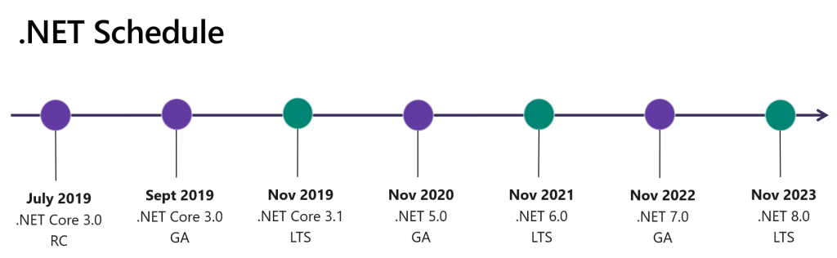
Notes:
https://devblogs.microsoft.com/dotnet/introducing-net-5/

Slide 11
.NET – A unified development platform
.NET
.NET FRAMEWORK
.NET Core
XAMARIN
APP
MODELS
WPF
Windows Forms
ASP.NET Core
UWP
iOS
Android
ASP.NET
OS X
Windows Forms
WPF
BASE
LIBRARIES
.NET Standard
.NET Framework BCL
.NET Core BCL
Mono BCL
Notes:
Notes: Even if we are reusing a lot across components (especially with the open sourcing last year), the reality is that each platform has its own implementation of the base libraries.
Note: .NET Framework BCL (Base Class Library) and Mono BCL are the same APIs, different implementation. .NET “Core Library” is a similar set of APIs, but different.

Slide 12
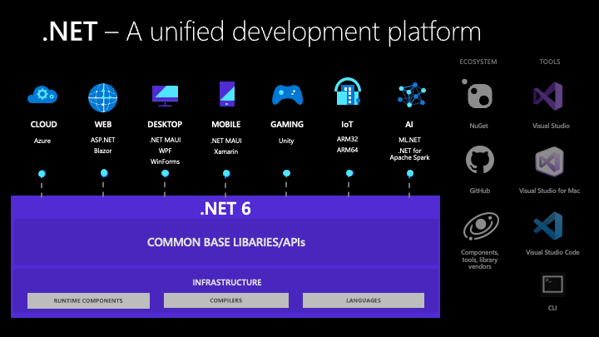
Notes:
Unified platform across browser, cloud, desktop, IoT, and mobile apps, all using the same .NET Libraries and the ability to share code easily.

Slide 13














Your platform for building anything
DESKTOP
WEB
CLOUD
MOBILE
GAMING
IoT
AI
.NET
Notes:
You can build anything with .NET. From desktop apps to cloud-native services, iPhone and Android mobile apps to artificial intelligence, you can build almost anything with the .NET platform.

Slide 14




.NET is a software development platform
TOOLS
DESKTOP
WEB
CLOUD
MOBILE
GAMING
IoT
AI
VISUAL STUDIO
.NET STANDARD
VISUAL STUDIO FOR MAC
LIBRARIES
VISUAL STUDIO CODE
INFRASTRUCTURE
RUNTIME COMPONENTS
COMPILERS
LANGUAGES
COMMAND LINE INTERFACE
Notes:
.NET is an entire software development platform that takes care of a lot of the heavy lifting for you when you want to build an application. Applications frameworks help you build the specific types of apps or workloads and enable you to literally build any app for any platform with any operating system. Each .NET workload shares a common infrastructure and .NET Standard library. This means not only are your .NET skills portable, but your actual code is portable no matter what you’re building. This makes it easy to share reusable components (called libraries) across the breadth of applications people build.
Additionally, there are a broad set of development tools that makes it really productive to write, debug, build and manage code bases.
See: www.dot.net

Slide 15
.NET Repositories
https://github.com/dotnet/runtime Contains the code to build the .NET runtime, libraries and shared host (dotnet) installers for all supported platforms, as well as the sources to .NET runtime and libraries.
https://github.com/dotnet/sdk Contains core functionality needed to create .NET projects, that is shared between Visual Studio and CLI.
https://github.com/dotnet/aspnetcore Contains the code for ASP.NET Core plus the following:
Documentation - documentation sources for https://docs.microsoft.com/aspnet/core/
Entity Framework Core - data access technology
Extensions - Logging, configuration, dependency injection, and more.
https://github.com/microsoft/WindowsAppSDK
Contains the code for Windows development formerly known as project reunion which decouples the application from specific version of windows and provides backward and forward compatibility.

Slide 16
Demo:
.NET is Open Source
Notes:
Demo Script:
Show the .NET links on github.com and explore them for the students
.NET Org: https://github.com/dotnet
Runtime: https://github.com/dotnet/runtime
ASP.NET Core: https://github.com/dotnet/aspnetcore
Compiler: https://github.com/dotnet/roslyn

Slide 17
Demo:
Create Console App
Notes:
This should be quick demo
Create Console App on both .NET framework and .NET core
Show that both are built from a similar code and runs the same
Show the Minimal APIs for .NET 7

Slide 18
Windows Development Evolution
Windows Forms (2002)
Windows Presentation Foundation (2007)
Windows Phone (2010)
Universal Windows 8 Apps (2013)
Universal Windows Platform (2015)
Multi-Platform App UI 2022 WinUI or Xamarin successor
Windows App SDK (2022) WinUI or formerly project reunion
Notes:
WPF:
Direct3D in App support
Modern User Interface (XAML)
Modern dev practices (MVVM, Observable pattern, abstractions …)
Better input support like touch and pen and output multi resolutions support
Web Extension with Limitation (Silverlight)
Windows Phone
Great concept for phones and bad execution (late to market etc)
Serious limitations.
Based on windows CE and Silverlight not Windows Runtime
Universal Windows 8 Apps
Designed for windows 8 “Metro Style” or “Modern” apps
Bridge between desktop and phone apps
Still had serious issues and limitations
Rushed to the release with little considerations
Universal Windows Platform
Polished and finalized Universal Platform
Windows Store
Designed for Windows 10 (which is supposed to be final version of windows)
Future proof with .NET Standard
Universal Compatibility and Based on Windows Runtime
Designed for multiple platforms (Phones, XBOX, Windows Tablet and PCs, Hololens etc)

Slide 19
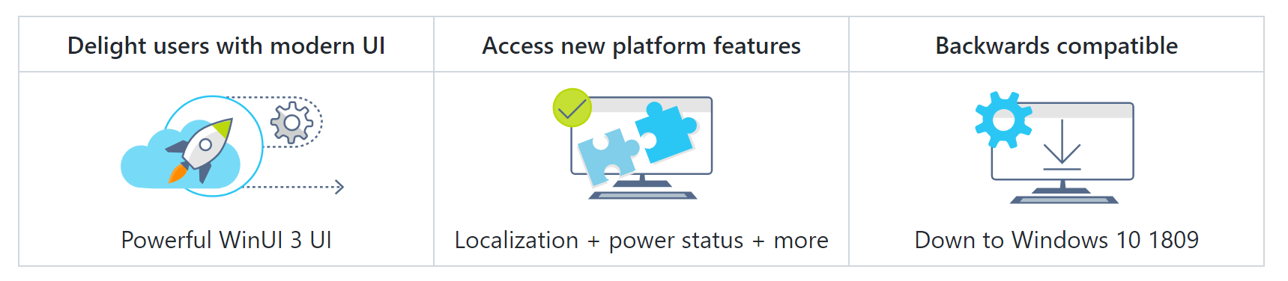
Windows App SDK – For Windows developers!
Formerly Known as Project Reunion
Use your current installer (no requirement to use MSIX, but there are reliability/security benefits to using MSIX!)
Additive platform APIs (only add what you need, leave the rest of your app as-is)
Works with Win32, WPF, WinForms, and more apps

Slide 20
How To Develop Windows Application
WinUI 3 and Windows App SDK is the new gold standard
WPF or WinForms Can be options for Win App SDK
MAUI is the native cross-platform option (WinUI 3 for Windows)
Non-native options for web developers can be either PWA, ReactNative or the use of WebView 2.0 with something like Blazor
Notes:
The Windows UI Library (WinUI) 3 is the latest and recommended user interface (UI) framework for Windows desktop apps, including managed apps that use C# and .NET and native apps that use C++ with the Win32 API. By incorporating the Fluent Design System into all experiences, controls, and styles, WinUI provides consistent, intuitive, and accessible experiences using the latest UI patterns.
WinUI 3 is available as part of the Windows App SDK. The Windows App SDK provides a unified set of APIs and tools that can be used in a consistent way by any C++ Win32 or C# .NET app on a broad set of target Windows OS versions.

Slide 21
Demo:
WinUI 3
Notes:
Show WinUI Gallery Demo app
https://github.com/microsoft/WinUI-Gallery

Slide 22
Demo:
MAUI, WPF and WinApp SDK
Notes:
Create Hello world with each of these and Compare XAML, Base Classes and Features.

Slide 23
.NET Standard

Slide 24
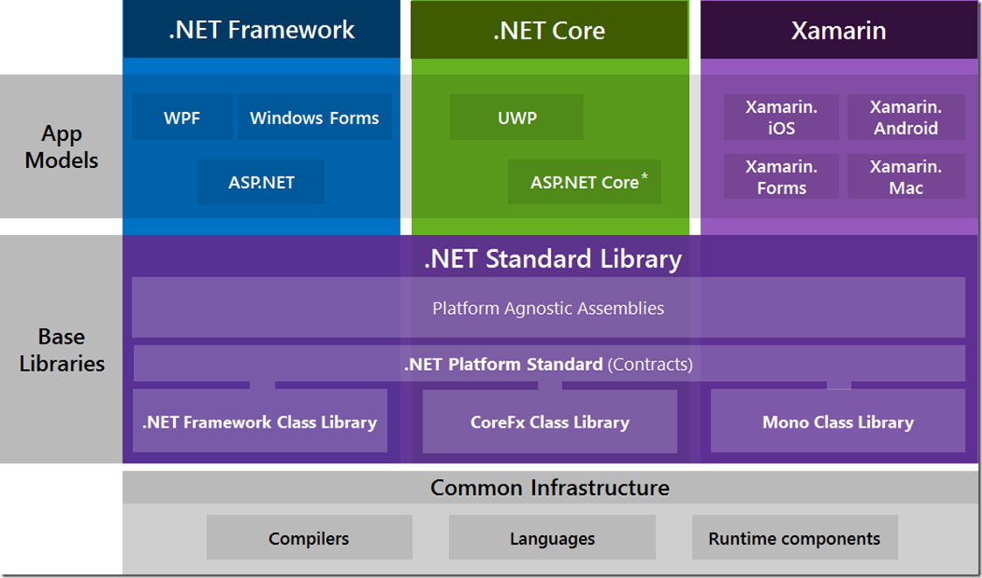

Slide 25


Motivation
Sharing code across platforms has some common challenges
API surfaces are
not uniform
New platforms may
not have the APIs
your library needs
Notes:
When we are trying to share code between platforms, there are often differences in APIs that are available to us.
[Next]
Since these platforms typically have different development teams, the APIs available can be slightly different; some might be very different. Think about trying to code a library that runs on multiple platforms in a situation like this. You must determine the set of APIs you need to implement your library, then examine each target platform to see which platforms have all the APIs you require. Some platforms may not have everything you need which means your library won’t be able to run there.
[Next]
As time goes by, new platforms may come out that we want to support. When a new platform appears, there’s no guarantee our existing library will work on it. The new platform may not implement one of the APIs that our library needs. This means you need to evaluate each new platform for compatibility with your library.
We want a way to share code that can handle both of these situations, and that’s exactly what .NET Standard allows.

Slide 26
Platforms
In .NET, a platform is a set of software components capable of building and executing an application on some target operating systems
.NET Framework
(Desktop/Server/Mobile)
.NET Core
(Server/Desktop)
Mono for Xamarin
(Mobile/Desktop)
Tools
Runtime
Library
Tools
Runtime
Library
Tools
Runtime
Library
The three primary Microsoft platforms let you run apps on a wide range of targets
Notes:
Platform gets used to describe a lot of things in development. In PCLs, we generally used platform as a synonym for operating system or an app model within an operating system. When we talk about the platforms in .NET Standard, it describes a set of components that allow us to build and execute an application on a set of target operating systems.
[Next]
Here we have the three most common .NET platforms you’ll likely run into. They each allow us to run apps on a large variety of devices and operating systems.
Each platform is going to have tools, like a compiler; a runtime, like the CLR; and library. We want to share code across platform libraries.
[Instructor Notes]
This course isn’t a great place to discuss the relationship between .NET Core and .NET Standard. On the simple end of things, .NET Core is just a platform that implements the .NET Standard (a concept discussed in later slides). If students really want to know more, Immo Landwerth has put together a fantastic set of videos on YouTube going into more details.
https://www.youtube.com/channel/UCaFP8iQMTuPXinXBMEXsSuw

Slide 27
Library variation
The libraries offered by each platform are different – they do not provide a uniform API surface for you to code against
.NET Framework
.NET Core
Mono for Xamarin
Tools
Runtime
Library
Tools
Runtime
Library
Tools
Runtime
Library
This makes it difficult for you to write one library that works on all these
platforms – what if you need to use an API that's not available everywhere?
Notes:
These various .NET platforms have libraries developed by different teams, often with a focus on their specific operating systems.
[Next]
They don’t provide the exact same surface area to code against. For example, what if you want to use an API that exists in an identical form in .NET Framework and .NET Core, but is slightly different within Mono? How can you write a single library using that API?

Slide 28
What is .NET Standard?
.NET Standard is a library specification that provides the same APIs across all .NET platforms
.NET Framework
.NET Core
Mono for Xamarin
Tools
Runtime
.NET
Standard
Tools
Runtime
.NET
Standard
Tools
Runtime
.NET
Standard
This makes it easier to build a library that works on all these platforms
since the available APIs are standardized
Notes:
The goal of .NET Standard is to alleviate the inconsistencies that can exist between APIs.
The .NET Standard is a specification. It’s not an implementation at all; it is a “standard” for a platform library to implement. This creates a consistent API across all the platforms.
[Next]
For example, these three platforms do offer .NET Standard implementations of that standard API surface. This makes it easier for you to write a single library that runs on all three of these platforms.
This doesn’t mean they will all implement the .NET Standard exactly the same. Behind the APIs, the implementation might vary; but also, the can be some differences in what is implemented based on the specific .NET Standard they choose to implement.

Slide 29
.NET Standard versions
.NET Standard is under active development and has many versions – each new version increases the number of available APIs
2.0 (Q3 2017)
1.1
1.6
...
1.0
New versions are
supersets, they
do not remove
any existing APIs
Notes:
.NET Standard is not just a single release; it is available in a number of versions and continues to grow. Currently, we have versions 1.0 through 1.6, with version 2.0 coming out this year.
[NEXT]
As this diagram hints, each version is a superset of the last version’s APIs. New APIs are added, but APIs are not removed. If an API is available in 1.1, it will also exist in version 1.6 and beyond. Your libraries will continue to be compatible with newer releases of .NET Standard.

Slide 30
Available APIs
The .NET team at Microsoft decides which APIs to add to each .NET Standard release (this includes a public feedback process)
Version | APIs | API count
1.0 | Primitives, reflection, tasks, collections, LINQ to Objects, XML, ... | 7,949
1.1 | Concurrent collections, interop, HTTP interactions, ... | 10,239
1.2 | Threading timer, more interop, ... | 10,285
1.3 | Console, file system, thread pool, sockets, cryptography, ... | 13,122
1.4 | More cryptography, ... | 13,140
1.5 | More assembly members, more streams, ... | 13,355
1.6 | Even more cryptography, more regex, expression compiling, ... | 13,501
2.0 (Q3 2017) | Data classes, drawing, pipes, caching, SMTP, web sockets, more serialization, XPath, expanded many existing classes, … | 32,638
Notes:
In the early versions of .NET Standard, the APIs were focused on what was available in common PCL Profiles. Starting with the APIs needed for the most basic .NET libraries – things like collections, new methods and classes were added to get to the next compatibility level with a Profile with more available APIs.
All the basics we come to expect, from dictionaries and networking to threading and cryptography are present in .NET Standard. Some were added in version 1.0, and others have been added later and evolved with additional APIs.
Looking at the API count’s growth, we had a large set of initial APIs and slowly grew from there. When version 2.0 comes out later this year, it will be a significant jump in API surface available to targeting libraries, more than double.
[Instructor Notes]
“APIs” is an undefined term from the .NET Standard GitHub repo. It likely means public members (functions, property gets and sets, and each enum option).
Reference: https://github.com/dotnet/standard/blob/master/docs/faq.md#if-there-is-no-breaking-change-why-call-it-net-standard-20

Slide 31


.NET Standard API use
Your library can use .NET Standard APIs added in versions less than or equal to your target version
My .NET Standard lib
Target framework:
.NETStandard 1.4 ˅
.NET Standard
v1.0 APIs
.NET Standard
v1.1 APIs
.NET Standard
v1.2 APIs
.NET Standard
v1.3 APIs
.NET Standard
v1.4 APIs
.NET Standard
v1.5 APIs
.NET Standard
v1.6 APIs
Notes:
Let’s look at what picking one of those versions will mean to a library we create. When we pick our target .NET Standard version in the project properties, that version number determines which APIs you are allowed to use.
[Next]
I’ve picked 1.4 as my target version here, so I can use all these APIs, all the ones added in 1.0 through to the matching 1.4 version.
[Next]
However, I will not be able to use the APIs added in versions later than my target version: 1.5, 1.6, or later.
So, when we pick our version, we want to pick the version that includes all the APIs we need to implement our library.

Slide 32
Platform support
Each platform can support its preferred version of .NET Standard
.NET Framework v4.6.2
.NET Core v1.0
Xamarin Cycle 9
Tools
Runtime
v1.5
Tools
Runtime
v1.6
Tools
Runtime
v1.6
Notes:
While we want to pick a higher .NET Standard version for more APIs, it’s not quite as simple as that. Each platform could implement a different .NET Standard version. We need to balance the API size of later versions with the compatibility of platforms we wish to support.
Here are some real-world examples, but keep in mind that each platform may come out with newer versions that offer support for larger .NET Standard versions.

Slide 33
Where can your library be used?
Your library can be used by platforms supporting your targeted .NET Standard version or higher
My .NET Standard lib
Target framework:
.NETStandard 1.4 ˅
.NET Framework v4.5.1
.NET Core v1.0
Xamarin Cycle 9
Tools
Runtime
v1.2
Tools
Runtime
v1.6
Tools
Runtime
v1.6
Notes:
So, we have our library targeting .NET Standard 1.4. Where can we use our library?
[Next]
What about this one? Notice I dropped the .NET Framework version, which affected the .NET Standard version that is supported. Can I run my .NET Standard 1.4 library on a .NET Standard platform that supports version 1.2?
[Next]
This isn’t possible. My library could use version 1.4 APIs that are not available on this platform.
[Next]
Here are two more real-world examples that support all the APIs available up through version 1.6.
[Next]
Since every API that we might use in this 1.4 library are available in 1.6, so our library can run on both of these platforms.

Slide 34
Which libraries can you reference?
A library targeting .NET Standard can reference a library targeting the same .NET Standard version or lower
Library A
Target framework:
.NETStandard 1.4 ˅
Library B
Library C
Library D
Target framework:
Target framework:
Target framework:
.NETStandard 1.1 ˅
.NETStandard 1.4 ˅
.NETStandard 1.6 ˅
Notes:
What about compatibility with other libraries? You might be working on a team making other libraries that need to work with yours.
[Next]
Suppose you have this library targeting .NET Standard 1.4. What other .NET Standard libraries can we use with our library?
[Next]
Do you think your 1.4 library can reference this library targeting .NET Standard 1.1?
[Next]
Yes, you can. Inside your library, you might use a bunch of .NET Standard APIs. Inside this other library, it is using a smaller subset of APIs.
Another way to explain this is that this 1.1 library isn’t doing anything that we couldn’t have done ourselves in our version 1.4 library, so we can reference it.
[Next]
Here’s another example where the versions are the same.
[Next]
Again, this one is also fine to reference. Using that same test, Library C isn’t calling any APIs I couldn’t call myself.
[Next]
What about with this 1.6 library? Can we reference that?
[Next]
The answer here is no. This library could be using APIs that aren’t available to my in .NET Standard 1.4. So I can’t magically get 1.6 methods by referencing someone else’s library who is calling APIs I couldn’t call myself.
[Instructor Notes]
You can use this slide like an unofficial Flash Quiz by showing each Library and asking if the first Library can reference it before revealing the answer.

Slide 35
How to choose target version
You should target the lowest .NET Standard version that gives you all the APIs you need – this maximizes the number of platforms you can run on
Which target version
should you choose?
My Library
My Library
Target framework:
Target framework:
.NETStandard 1.6 ˅
.NETStandard 1.2 ˅
Targeting higher means
you can use more APIs
(e.g. any APIs added
in 1.0 through 1.6)
Targeting lower means you
are compatible with more
platforms (e.g. all that
support at least 1.2)
Notes:
One of our main tasks is choosing a target .NET Standard version for our libraries. This is resolving a conflict between two goals. Why might we choose version 1.6 over 1.2?
[Next]
We could choose version 1.6 to make sure we have the largest count of APIs available for us to use in our library. We could use APIs added in version 1.0 all the way through version 1.6.
Unfortunately, this isn’t the whole situation for us to consider.
[Next]
Targeting a lower .NET Standard version has an advantage to us as well. Lower versions can run on more platforms; our library can be used in more places.
This may not be a simple decision to make, but there is a general guideline: target the lowest version that gives you the APIs you need. You get the APIs you need to accomplish what your library should do, but also makes your library useful on as many platforms as possible.

Slide 36
.NET Before – Reuse Code!
.NET FRAMEWORK
.NET
XAMARIN
APP
MODELS
WPF
Windows Forms
ASP.NET Core
UWP
iOS
Android
ASP.NET
OS X
Windows Forms
WPF
BASE
LIBRARIES
.NET Framework BCL
.NET BCL
Mono BCL
Notes:
Notes: Even if we are reusing a lot across components (especially with the open sourcing last year), the reality is that each platform has its own implementation of the base libraries.
Note: .NET Framework BCL (Base Class Library) and Mono BCL are the same APIs, different implementation. .NET “Core Library” is a similar set of APIs, but different.

Slide 37
.NET Now
.NET FRAMEWORK
.NET
XAMARIN
APP
MODELS
WPF
Windows Forms
ASP.NET Core
UWP
iOS
Android
OS X
ASP.NET
Windows Forms
WPF
BASE
LIBRARIES
.NET Standard

Slide 38
.NET Standard Library
Goal: Establish greater uniformity in the .NET ecosystem
A set of APIs that all .NET platforms have to implement
Unifies the .NET platform and prevents future fragmentation
.NET Standard will replace Portable Class Libraries (PCLs)
Addresses three main scenarios:
Defines uniform set of BCL APIs for all .NET platforms to implement, independent of workload
Enables developers to produce portable libraries that are usable across .NET runtimes, using the same set of APIs
Reduces and hopefully eliminates conditional compilation of shared source due to .NET APIs
Notes:
https://docs.microsoft.com/en-us/dotnet/articles/standard/library
The .NET Standard is a formal specification of .NET APIs that are intended to be available on all .NET implementations. The motivation behind the .NET Standard is establishing greater uniformity in the .NET ecosystem.

Slide 39
.NET Standard Versions
.NET Standard | 1.0 | 1.1 | 1.2 | 1.3 | 1.4 | 1.5 | 1.6 | 2.0 | 2.1
.NET | 5.0 | 5.0 | 5.0 | 5.0 | 5.0 | 5.0 | 5.0 | 5.0 | 5.0
.NET Core | 1.0 | 1.0 | 1.0 | 1.0 | 1.0 | 1.0 | 1.0 | 2.0 | 3.0
.NET Framework | 4.5 | 4.5 | 4.5.1 | 4.6 | 4.6.1 | 4.6.1 | 4.6.1 | 4.6.1 | N/A
Mono | 4.6 | 4.6 | 4.6 | 4.6 | 4.6 | 4.6 | 4.6 | 5.4 | 6.4
Xamarin.iOS | 10.0 | 10.0 | 10.0 | 10.0 | 10.0 | 10.0 | 10.0 | 10.14 | 12.16
Xamarin.Mac | 3.0 | 3.0 | 3.0 | 3.0 | 3.0 | 3.0 | 3.0 | 3.8 | 5.16
Xamarin.Android | 7.0 | 7.0 | 7.0 | 7.0 | 7.0 | 7.0 | 7.0 | 8.0 | 10.0
Universal Windows Platform | 10.0 | 10.0 | 10.0 | 10.0 | 10.0 | 10.0.16299 | 10.0.16299 | 10.0.16299 | TBD
Unity | 2018.1 | 2018.1 | 2018.1 | 2018.1 | 2018.1 | 2018.1 | 2018.1 | 2018.1 | 2021.2.0b6
.NET Framework won't support .NET Standard 2.1 or later versions.
Notes:
Link: https://docs.microsoft.com/en-us/dotnet/standard/net-standard
Shows the minimum version of .net standard support for each .net platform.
Next slide will show an animation to explain it more.

Slide 40
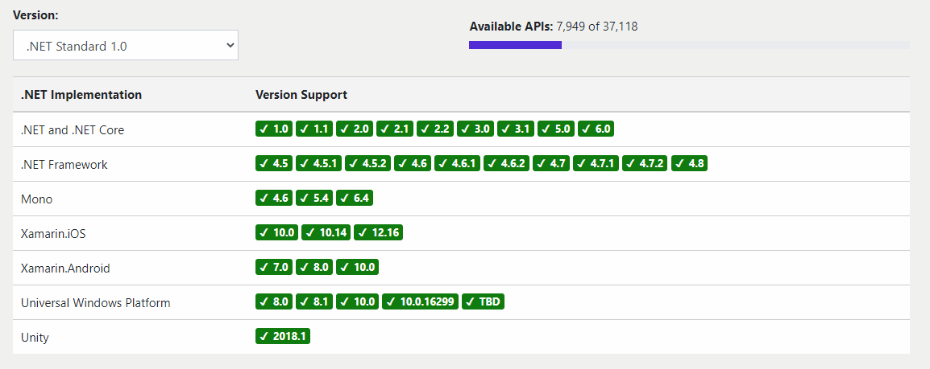
.NET Standard Versions Illustration
Source: https://dotnet.microsoft.com/platform/dotnet-standard#versions
Notes:
Animation to show the supported .net standard version for all .net platform.

Slide 41
What version should you target?
The higher the version, the more APIs you have
The lower the version, the more platforms support it
Target the lowest version you can get away with!
Lower Version
Higher Version
More Reach
More APIs

Slide 42
When to target net6.0 vs. netstandard
net6.0
When building an executable project (console app, ASP.NET Core app, etc.).
netstandard2.0
When you build a reusable libraries that you plan to ship on NuGet, consider the trade-off between reach and available feature set. This would support the .NET (Core) and .NET Framework.
Use .NET Standard 2.1 if you need features only available in that target and are ok not supporting .NET Framework.
When the project or its dependencies need APIs not present in .NET Standard.
Notes:
Decision Tree

Slide 43
Demo:
.NET Standard
Notes:
Demo Script:
Create an empty project and call it NetStandardDemo
Create a .NET Standard Class library called NetStandardLib and use netstandard2.0
Rename Class1 to Helper
Create a static method inside Helper class: public static DateTime GetDate() => DateTime.Now;
Create a Console App (.NET Framework) with version 4.6.1
Add a reference to NetStandardLib project.
Call GetDate() method from NetStandardLib
Create a Console App (.NET Core)
Add a reference to NetStandardLib project
Call GetDate() method from NetStandardLib
Show that you can reference .NET standard lib and you can try with .NET framework 4.8 also.

Slide 44
C# Requirement for WPF

Slide 45
Why C# ?
It is amongst top 5 most popular programing language
It is object oriented and intended for large apps by design
Enterprise and security features out of the box
It has great C like syntax readability
Great unmatched Async and parallel library support
Used mostly in server apps and games for performance

Slide 46
Top Features of C#
Basics: Iterators, OOP Features, Low level IO and Data support
Collection and Generics
Language Integrated Query (LINQ)
Async-Await and Parallel Programming
Static and strongly typed but dynamic features have been added
Native Interop

Slide 47
Fundamentals of C# Language
Classes and objects - Inheritance, polymorphism
Memory allocation (Heap vs Stack)
Properties and Methods
Generics and Anonymous Types
Interfaces and Encapsulation
Collections and Language Integrated Query (LINQ)
Events and Delegates
Asynchronous Programming and Parallel Library

Slide 48
Classes and objects
public class Person
{
// Constructor that takes no arguments:
public Person()
{
Name = "unknown";
}
// Constructor that takes one argument:
public Person(string name)
{
Name = name;
}
public string Name { get; }
// Method that overrides the base class
// (System.Object) implementation.
public override string ToString()
{
return Name;
}
}
Classes are the most fundamental of C#'s types. A class is a data structure that combines state (fields) and actions (methods and other function members) in a single unit. A class provides a definition for instances of the class, also known as objects. Classes support inheritance and polymorphism, mechanisms whereby derived classes can extend and specialize base classes.

Slide 49
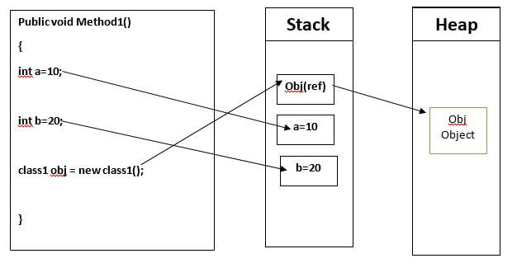
Memory allocation

Slide 50
Category | Stack Memory | Heap Memory
What is Stack & Heap? | It is an array of memory. It is a LIFO (Last In First Out) data structure. In it data can be added to and deleted only from the top of it. | It is an area of memory where chunks are allocated to store certain kinds of data objects. In it data can be stored and removed in any order.
What goes on Stack & Heap? | "Things" declared with the following list of type declarations are Value Types (because they are from System.ValueType): bool, byte, char, decimal, double, enum, float, int, long, sbyte, short, struct, uint, ulong, ushort | "Things" declared with following list of type declarations are Reference Types (and inherit from System.Object... except, of course, for object which is the System.Object object): class, interface, delegate, object, string
Memory Allocation | Memory allocation is Static | Memory allocation is Dynamic
How is it Stored? | It is stored Directly | It is stored indirectly
Is Variable Resized? | Variables can’t be Resized | Variables can be Resized
Access Speed | Its access is fast | Its access is Slow
How is Block Allocated? | Its block allocation is reserved in LIFO. Most recently reserved block is always the next block to be freed. | Its block allocation is free and done at any time
Visibility or Accessibility | It can be visible/accessible only to the Owner Thread | It can be visible/accessible to all the threads
In Recursion Calls? | In recursion calls memory filled up quickly | In recursion calls memory filled up slowly
Used By? | It can be used by one thread of execution | It can be used by all the parts of the application
StackOverflowException | .NET Runtime throws exception “StackOverflowException” when stack space is exhausted | -
When wiped off? | Local variables get wiped off once they lose the scope | -
Contains | It contains values for Integral Types, Primitive Types and References to the Objects | -
Garbage Collector | - | It is a special thread created by .NET runtime to monitor allocations of heap space. It only collects heap memory since objects are only created in heap

Slide 51
Properties and Methods
public class Example : ExampleBaseClass
{
private int myVar;
public int MyProperty
{
get { return myVar; }
set { myVar = value; }
}
public Example()
{
InitializeComponent();
}
void method1()
{
}
}
Properties and methods are members of the class. Property holds or exposes a state through getter or setter and method is the action that will be performed that may result in changing those states or internally or externally. There is also a special method that will be called when class is instantiated which has the same name as the class and is called constructor that may have different variations.

Slide 52
Generics
public class GenericList<T>
{
public void Add(T input) { }
}
class TestGenericList
{
private class ExampleClass { }
static void Main()
{
// Declare a list of type int.
GenericList<int> list1 = new GenericList<int>();
list1.Add(1);
// Declare a list of type string.
GenericList<string> list2 = new GenericList<string>();
list2.Add("");
// Declare a list of type ExampleClass.
GenericList<ExampleClass> list3 = new GenericList<ExampleClass>();
list3.Add(new ExampleClass());
}
}
Generics introduces the concept of type parameters to .NET, which make it possible to design classes and methods that defer the specification of one or more types until the class or method is declared and instantiated by client code. For example, by using a generic type parameter T, you can write a single class that other client code can use without incurring the cost or risk of runtime casts or boxing operations.

Slide 53
Anonymous Types
Anonymous types provide a convenient way to encapsulate a set of read-only properties into a single object without having to explicitly define a type first. The type name is generated by the compiler and is not available at the source code level. The type of each property is inferred by the compiler.
var v = new
{ Amount = 108, Message = "Hello" };
var productQuery =
from prod in products
select new
{ prod.Color, prod.Price };
foreach (var v in productQuery)
{
Console.
WriteLine($"Color={v.Color}, Price={v.Price}");
}

Slide 54
Interfaces and encapsulation
interface IEquatable<T>
{
bool Equals(T obj);
}
public class Car : IEquatable<Car>
{
public string? Make { get; set; }
public string? Model { get; set; }
public string? Year { get; set; }
public bool Equals(Car? car)
{
return (this.Make,
this.Model,
this.Year) ==
(car?.Make, car?.Model, car?.Year);
}
}
An interface defines a contract. Any class or struct that implements that contract must provide an implementation of the members defined in the interface. Interfaces encapsulate the details away from other modules makes it perfect for larger applications with lots of changes and parts. Additionally, it makes unit testing easy with mocked implementations.

Slide 55
Collection
Class | Description
Dictionary<TKey,TValue> | Represents a collection of key/value pairs that are organized based on the key.
List<T> | Represents a list of objects that can be accessed by index. Provides methods to search, sort, and modify lists.
Queue<T> | Represents a first in, first out (FIFO) collection of objects.
SortedList<TKey,TValue> | Represents a collection of key/value pairs that are sorted by key based on the associated IComparer<T> implementation.
Stack<T> | Represents a last in, first out (LIFO) collection of objects.

Slide 56
Language Integrated Query (LINQ)
LINQ is the name for a set of technologies based on the integration of query capabilities directly into the C# language. Traditionally, queries against data are expressed as simple strings without type checking at compile time or IntelliSense support. Furthermore, you have to learn a different query language for each type of data source: SQL databases, XML documents, various Web services, and so on. With LINQ, a query is a first-class language construct, just like classes, methods, events.
int[] numbers =
{ 5, 10, 8, 3, 6, 12 };
//Query syntax:
IEnumerable<int> numQuery1 =
from num in numbers
where num % 2 == 0
orderby num
select num;
//Method syntax:
IEnumerable<int> numQuery2 =
numbers
.Where(num => num % 2 == 0)
.OrderBy(n => n);

Slide 57
Events and Delegates
public class VideoEncoder
{
//1. Define a delegate, contract between publisher and subscriber.
//2. Define an event based on the delegate
//3. Raise the event
public delegate void
VideoEncodedEventHandler(object source, EventArgs args);
public event VideoEncodedEventHandler VideoEncoded;
public void Encode(Video video)
{
Console.WriteLine("Enconding video");
Thread.Sleep(3000);
OnVideoEncoded();
}
protected virtual void OnVideoEncoded() =>
VideoEncoded?.Invoke(this, EventArgs.Empty);
}

Slide 58
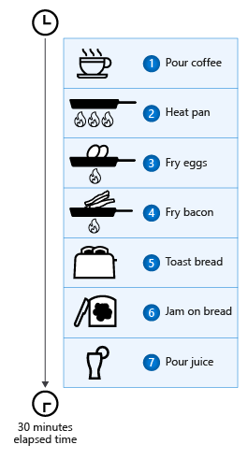
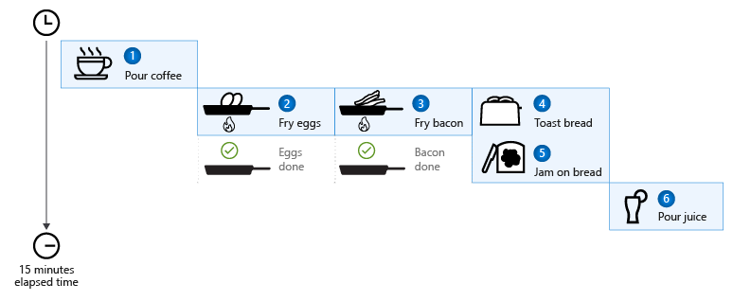
Asynchronous and Parallel Programming

Slide 59
Asynchronous and Parallel Programming
Coffee cup = PourCoffee();
Console.WriteLine("coffee is ready");
var eggsTask = FryEggsAsync(2);
var baconTask = FryBaconAsync(3);
var toastTask = MakeToastWithButterAndJamAsync(2);
var breakfastTasks = new List<Task>
{ eggsTask, baconTask, toastTask };
while (breakfastTasks.Count > 0)
{
Task finishedTask = await Task.WhenAny(breakfastTasks);
if (finishedTask == eggsTask)
{
Console.WriteLine("eggs are ready");
}
else if (finishedTask == baconTask)
{
Console.WriteLine("bacon is ready");
}
else if (finishedTask == toastTask)
{
Console.WriteLine("toast is ready");
}
breakfastTasks.Remove(finishedTask);
}
Juice oj = PourOJ();
Console.WriteLine("oj is ready");
Console.WriteLine("Breakfast is ready!");
Coffee cup = PourCoffee();
Console.WriteLine("coffee is ready");
Egg eggs = FryEggs(2);
Console.WriteLine("eggs are ready");
Bacon bacon = FryBacon(3);
Console.WriteLine("bacon is ready");
Toast toast = ToastBread(2);
ApplyButter(toast);
ApplyJam(toast);
Console.WriteLine("toast is ready");
Juice oj = PourOJ();
Console.WriteLine("oj is ready");
Console.WriteLine("Breakfast is ready!");

Slide 60
Demo:
C# Basics Demo
https://learn.microsoft.com/en-us/dotnet/csharp/
Notes:
https://learn.microsoft.com/en-us/dotnet/csharp/

Slide 61
WPF Basics
Objectives:
WPF Project Structure
Basic Application Lifecycle Hooks

Slide 62
WPF Project Structure

Slide 63
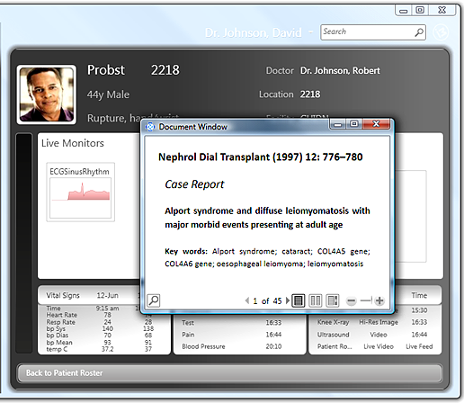
What is WPF
Windows Presentation Foundation (WPF) is a UI framework that creates desktop client applications. The WPF development platform supports a broad set of application development features, including an application model, resources, controls, graphics, layout, data binding, documents, and security

Slide 64
Why WPF
Modern Framework for Windows apps
Resolution-independent
Uses vector-based rendering engine
Build to take advantage of Modern Graphics Hardware
It has everything from its markup (XAML), controls, data binding, layouts, 2D and 3D graphics, animation, style, templates, media, text, and typography
It was brought to .NET Core Open-Source Project

Slide 65
Tale of two implementations
There are two implementations of WPF:
.NET version: Modern version still windows only even though .NET is cross platform. Open source and well maintained. Much better performance
.NET Framework 4 version: Older version based on .NET FX and it is supported. Legacy support. Some features are exclusive to .NET FX.
Notes:
There are two implementations of WPF:
1. .NET version (this guide):
An open-source implementation of WPF hosted on GitHub, which runs on .NET 5 or higher (including .NET Core 3.1). The XAML designer requires, at a minimum, Visual Studio 2019 version 16.8. Even though .NET is a cross-platform technology, WPF isn't and only runs on Windows.
2. NET Framework 4 version:
The .NET Framework implementation of WPF that's supported by Visual Studio 2019 and Visual Studio 2017.
.NET Framework 4 is a Windows-only version of .NET and is considered a Windows Operating System component. This version of WPF is distributed with .NET Framework. For more information about the .NET Framework version of WPF, see Introduction to WPF for .NET Framework.

Slide 66
Advantage of .NET version over FX
Better Support & Actively developed
.NET version bundles with App not OS
Performance is much better
Support more hardware including ARM
SDK style projects, support modern packages.
Open Source and Microsoft Support
Applications will be smaller
Some features are dropped for security reasons

Slide 67
Program with WPF
WPF exists as a subset of .NET types that are, mostly located in the System.Windows namespace. If you have previously built applications with .NET with frameworks like ASP.NET and Windows Forms, the fundamental WPF programming experience should be familiar, you:
Instantiate classes
Set properties
Call methods
Handle events
WPF includes more programming constructs that enhance properties and events: dependency properties and routed events.

Slide 68
Markup and code-behind
WPF lets you develop an application using both markup and code-behind, an experience with which ASP.NET developers should be familiar. You generally use XAML markup to implement the appearance of an application while using managed programming languages (code-behind) to implement its behavior. This separation of appearance and behavior has the following benefits:
Development and maintenance costs are reduced because appearance-specific markup isn't tightly coupled with behavior-specific code.
Development is more efficient because designers can implement an application's appearance simultaneously with developers who are implementing the application's behavior.
Globalization and localization for WPF applications is simplified.

Slide 69
Application Class
App.xaml is the declarative starting point of your application. Visual Studio will automatically create it for you when you start a new WPF application, including a Code-behind file called App.xaml.cs. They work much like for a Window, where the two files are partial classes, working together to allow you to work in both markup (XAML) and Code-behind.
The main thing to notice here is the StartupUri property. This is actually the part that instructs which Window or Page to start up when the application is launched. In this case, MainWindow.xaml will be started, but if you would like to use another window as the starting point, you can simply change this. In some situations, you want more control over how and when the first window is displayed. In that case, you can remove the StartupUri property and value and then do it all from Code-Behind instead.
<Application x:Class="WpfTutorialSamples.App"
xmlns="http://schemas.microsoft.com/winfx/2006/xaml/presentation"
xmlns:x=http://schemas.microsoft.com/winfx/2006/xaml
StartupUri="MainWindow.xaml">
<Application.Resources>
</Application.Resources>
</Application>

Slide 70
Main Application Window
In XAML: Application.StartupUri Property StartupUri=“NameSpace/Window.xaml"
In XAML: Application.MainWindow
<Application.MainWindow>
<local:Window2 Visibility="Visible" />
</Application.MainWindow>
Application.Startup
private void Application_Startup(object sender, StartupEventArgs e)
{
// Create the window
Window1 window = new Window1();
// Or Just Open the window
window.Show();
}
Notes:
1. StartupUri=“NameSpace/Window.xaml"
2. <Application.MainWindow> <local:Window2 Visibility="Visible" /> </Application.MainWindow>
3.
private void Application_Startup(object sender, StartupEventArgs e)
{
// Create the window
Window1 window = new Window1();
//Set Main Window and Show
Application.Current.MainWindow = new Window1();
Application.Current.MainWindow.Show();
// Or Just Open the window
window.Show();
}

Slide 71
Demo:
WPF Project Structure
Notes:
Show Code Behinds, App.XAML

Slide 72
Basic Application Lifecycle Hooks

Slide 73
WPF Application Lifecycle
Startup: This is the first lifetime event of Application to get fired. This is the event where you can process any command line arguments received by your application.
Activated: Called every time when this app's window comes foreground and also the first-time app's window is rendered. Please note that only after this event window's Activated event will be fired.
Deactivated: Happens if user switches to another application (by Alt-Tab, taskbar or task manager etc.) or as effect of application closure.
Exit: if you have written your custom main() method instead of a generated one still you can add some business logic code here. Any quick resource freeing can be done here.
SessionEnding: This event is fired when user logs off from the system. Same can be cancelled by setting SessionEndingCancelEventArgs e.cancel as true.
Notes:
A window is divided into two areas: the non-client area and client area.
The non-client area of a window is implemented by WPF and includes the parts of a window that are common to most windows, including the following:
A title bar (1-5).
An icon (1).
Title (2).
Minimize (3), Maximize (4), and Close (5) buttons.
System menu (6) with menu items. Appears when clicking on the icon (1).
Border (7).
The client area of a window is the area within a window's non-client area and is used by developers to add application-specific content, such as menu bars, tool bars, and controls.
Client area (8).
Resize grip (9). This is a control added to the Client area (8).

Slide 74
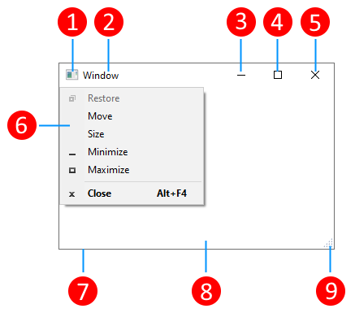
Overview of WPF Windows
In WPF, a window is encapsulated by the Window class that you use to do the following:
Display a window.
Configure the size, position, and appearance of a window.
Host application-specific content.
Manage the lifetime of a window.
Notes:
A window is divided into two areas: the non-client area and client area.
The non-client area of a window is implemented by WPF and includes the parts of a window that are common to most windows, including the following:
A title bar (1-5).
An icon (1).
Title (2).
Minimize (3), Maximize (4), and Close (5) buttons.
System menu (6) with menu items. Appears when clicking on the icon (1).
Border (7).
The client area of a window is the area within a window's non-client area and is used by developers to add application-specific content, such as menu bars, tool bars, and controls.
Client area (8).
Resize grip (9). This is a control added to the Client area (8).

Slide 75
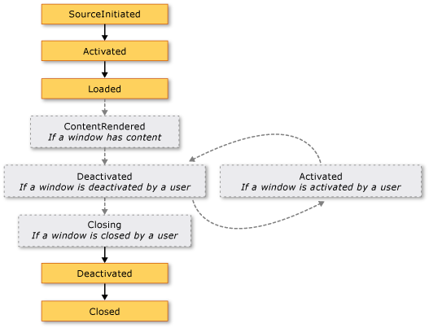
Window Lifecycle
When ShowActivated is true (default)
Notes:
When ShowActivated Boolean is set to false “Activated” method won’t execute

Slide 76
Window vs Page vs User Controls
Window object is just what it sounds like: its a new Window for your application. You should use it when you want to pop up an entirely new window. we don't often use more than one Window in WPF because we prefer to put dynamic content in my main Window that changes based on user action.
Page is a page inside your Window. It is mostly used for web-based systems like an XBAP, where you have a single browser window and different pages can be hosted in that window. It can also be used in Navigation Applications.
UserControl is a reusable user-created control that you can add to your UI the same way you would add any other control. Usually, we create a UserControl when we want to build in some custom functionality (for example, a CalendarControl), or when we have a large amount of related XAML code, such as a View when using the MVVM design pattern.

Slide 77
Window vs Page vs User Controls
Window represents a window object for “Windows” application.
Page must be hosted inside a window or a frame.
User Control meant to be reused inside windows
Page can’t host a window but usually host user controls
User control and page are very similar
User control doesn’t have Page limitations

Slide 78
Implementing a dialog box
❌ DON'T clutter the dialog window. The dialog experience is for the user to enter some data, or to make a choice.
✔️ DO provide an OK button to close the window.
✔️ DO set the OK button's IsDefault property to true to allow the user to press the ENTER key to accept and close the window.
✔️ CONSIDER adding a Cancel button so that the user can close the window and indicate that they don't want to continue.
✔️ DO set the Cancel button's IsCancel property to true to allow the user to press the ESC key to close the window.
✔️ DO set the title of the window to accurately describe what the dialog represents, or what the user should do with the dialog.
✔️ DO set minimum width and height values for the window, preventing the user from resizing the window too small.
✔️ CONSIDER disabling the ability to resize the window if ShowInTaskbar is set to false. Disable by setting ResizeMode to NoResize

Slide 79
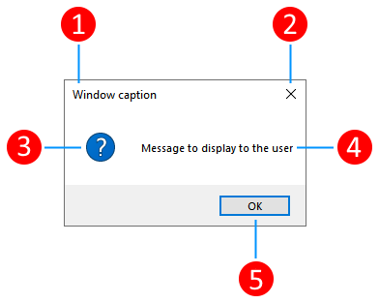
Display Message Box
string messageBoxText = "Do you want to save changes?";
string caption = "Word Processor";
MessageBoxButton button = MessageBoxButton.YesNoCancel;
MessageBoxImage icon = MessageBoxImage.Warning;
MessageBoxResult result;
result = MessageBox.Show(messageBoxText, caption, button, icon, MessageBoxResult.Yes);
Notes:
A title bar with a caption (1).
A close button (2).
Icon (3).
Message displayed to the user (4).
Response buttons (5).

Slide 80
Demo:
WPF Lifecycle hooks
Notes:
https://www.codeproject.com/articles/403418/lifetime-events-of-a-wpf-application

Slide 81
XAML Basics
Objectives:
XAML Basics
XAML Controls and Layouts
Basic Event Handlind

Slide 82
XAML Basics

Slide 83

Advantages of markup
HTML has taught us that markup languages are a great way to define user interfaces because they are:
Toolable
Human readable
Extensible
Notes:
We are going to talk about XAML – a markup language originally created by Microsoft to describe user interfaces in WPF.
When Microsoft started designing XAML in 2001 [This was when the Avalon project kicked off], they pulled from a variety of internal teams for advice and, in particular, they took a lot of hints from the DHTML group which was defining the HTML specifications for Internet Explorer.
The timeframe is important, a lot of people ask why Microsoft built XAML at all – why not use HTML and CSS? It becomes clear when you realize that XAML and WPF was being designed long before HTML had solid standards. CSS didn't really exist yet, and most browsers interpreted HTML slightly differently. As a result, it just wasn't mature enough, and it didn't really offer the power or flexibility we see today.
However, there were several key benefits that were recognized in the HTML design
[Next to animate in points]
First, markup languages are toolable – that means we can create UI design tools and programs which emit markup and keep us from having to get into the low-level details.
Second, if we want to get into the details, it's human readable – so we can hand-edit it and look through it to understand the UI it describes.
Finally, markup languages tend to be extensible and support new tags which were not originally created as part of the language.
These are all important key benefits and all extend to XAML when we are creating our application Uis.

Slide 84
What is XAML?
Extensible Application Markup Language (XAML) is a markup language created by Microsoft specifically to describe UI
WPF (2006)
Silverlight (2008)
Windows Phone
(2010)
Super powerful UI Design tool
WinRT (2012)
XAML
Notes:
Enter XAML. XAML stands for the "Extensible Application Markup Language" and was created by Microsoft specifically to create UI graphs like Xamarin.Forms.
[Next to animate in each point]
As I mentioned, XAML started life with the WPF project at Microsoft. This was released in 2006 as part of .NET 3.0 (or NETFX which was a much cooler name).
It was then used with Silverlight, which was a bright star that burned out quickly
It is currently used by WinRT and UWP for both .NET and C++ applications
and finally was used with Windows Phone to create mobile UI screens.
And now you can use it with Xamarin.Forms
XAML is used by every major application platform used by Microsoft today, is very mature, highly extensible and easy to understand because it doesn't introduce it's own tags but instead uses the underlying object model for the UI screens being designed. As such, it's a great way to describe your Xamarin.Forms screens.

Slide 85
XAML benefits
Designer Friendly
Separation of UI from Behavior
Potential for division of labor
XAML
Notes:
There are three primary benefits we get out of using XAML, which address the concerns we raised with building our UI in code.
[Next to animate the points]
First, there's a potential to introduce a designer role into the development workflow. By this, I mean another team member that designs the screens for you. This role can be generating UI assets and screens which are used directly in the development process with little to no involvement from the developer.
Second, it integrates nicely with designer tools. Microsoft invested heavily in this, writing three different designers at different points, today they use Blend for everything (it's integrated into VS and is still getting a lot of love). Unfortunately, Xamarin doesn't have a designer yet, but they will at some point. Today we edit the files as XML text with some limited intellisense.
Finally, and most importantly, it encourages a separation of UI design from the behavior of the UI. That makes it easier to adjust the UI visuals, add animations, change fonts and colors, without impacting our logic or introducing bugs in our code since the UI design isn't contained in the code.

Slide 86
What can XAML do?
XAML can ...
Initialize objects
Set properties of objects
These code snippets achieve the same result.
XAML
C#
<Button Content="Click me!"
HorizontalAlignment="Center"
VerticalAlignment="Center"
MinWidth="75" />
new Button
{
Content = "Click me!",
HorizontalAlignment = HorizontalAlignment.Center,
VerticalAlignment = VerticalAlignment.Center,
MinWidth = 75
};
Notes:
XAML can initialize objects and set properties of objects.
Written in XAML can be written in C#.
The code snippet below writes the same using XAML and C #.

Slide 87
Property element syntax / Collection syntax
You can assign another object element as value of a property.
If the property type is a collection, then the child elements become the items in the collection.
These code snippets achieve the same result.
<Button Content="Click me!">
<Button.ContextFlyout>
<MenuFlyout>
<MenuFlyout.Items>
<MenuFlyoutItem Text="First item" />
<MenuFlyoutItem Text="Second item" />
</MenuFlyout.Items>
</MenuFlyout>
</Button.ContextFlyout>
</Button>
new Button
{
Content = "Click me!",
ContextFlyout = new MenuFlyout
{
Items =
{
new MenuFlyoutItem { Text = "First item" },
new MenuFlyoutItem { Text = "Second item" },
}
}
};
Notes:
you can assign other object elements to be the value of a property. This capability is enabled by the property element syntax. Instead of the property being specified as an attribute within the element tag, the property is specified using an opening element tag in elementTypeName.propertyName form, the value of the property is specified within, and then the property element is closed. In this code snippets, “Button.ContextFlyout” is written property element syntax.
If the type of a property is a collection, then the inferred collection type does not need to be specified in the markup as an object element. Instead, the elements that are intended to become the items in the collection are specified as one or more child elements of the property element. In this code snippets, Children of “MenuFlyout.Items” is collection syntax.

Slide 88
XAML content properties
Child elements placed inside a tag are automatically set to the ContentProperty
The ContentProperty is set using the ContentPropertyAttribute class.
These code snippets achieve the same result.
<Button>Hello world</Button>
new Button
{
Content = "Hello world"
};
Eg.: The ContentProperty of the Button class is called Content
Notes:
XAML content syntax is a syntax that is only enabled on classes that specify the ContentPropertyAttribute as part of their class declaration. The ContentPropertyAttribute references the property name that is the content property for that type of element (including derived classes). When processed by a XAML processor, any child elements or inner text that are found between the opening and closing tags of the object element will be assigned to be the value of the XAML content property for that object.
In this code snippets, The ContentProperty of Button class is “Content” property, then “Hello world” is set to a “Content” property of a Button class.

Slide 89
Content properties and List syntax combined
If the type of ContentProperty is a collection, then you can combine them.
These code snippets achieve the same result.
Collection syntax only
Content properties and Collection syntax
<MenuFlyout>
<MenuFlyout.Items>
<MenuFlyoutItem Text="First item" />
<MenuFlyoutItem Text="Second item" />
</MenuFlyout.Items>
</MenuFlyout>
<MenuFlyout>
<MenuFlyoutItem Text="First item" />
<MenuFlyoutItem Text="Second item" />
</MenuFlyout>
The ContentProperty of the MenuFlyout class is the Items property.
When the property type is collection, then you can set multiple elements directly in the ContentProperty.
Notes:
If an element has a XAML content property and the type of the XAML content property is a collection, then the implied collection type does not need to be specified in the markup as an object element and the XAML content property does not need to be specified as a property element. Therefore the apparent content model in the markup can now have more than one child element assigned as the content.

Slide 90
Markup Extensions
Markup Extensions can execute some custom logic to retrieve or set a value
Syntax: {ExtensionName constructor argumenst..., PropertyName=Value, ...}
Example
<Grid Background="{StaticResource AppBarBackgroundThemeBrush}">
StaticResourceExtension gets a value from the application’s resources.
Notes:
XAML defines a markup extension programming entity that enables an escape from the normal XAML processor handling of string attribute values or object elements, and defers the processing to a backing class.
In this slide, using the StaticResourceExtension. This markup extension gets a value from Resources. As other markup extensions to be explained later, x:Bind markup extension, Binding extension and more.

Slide 91
Attached properties
Attached properties enable additional property/value pairs to be set on an object.
You set attached properties by using the syntax AttachedPropertyProvider.PropertyName.
Example
<Canvas>
<Button Content="Hello"
Canvas.Left="50"
Canvas.Top="50" />
</Canvas>
Canvas.Left and Canvas.Top are attached properties.
Notes:
Attached properties are a programming concept introduced in XAML whereby properties can be owned and defined by a particular type, but set as attributes or property elements on any element. The primary scenario that attached properties are intended for is to enable child elements in a markup structure to report information to a parent element without requiring an extensively shared object model across all elements. This scenario is used in layout controls like this example.

Slide 92
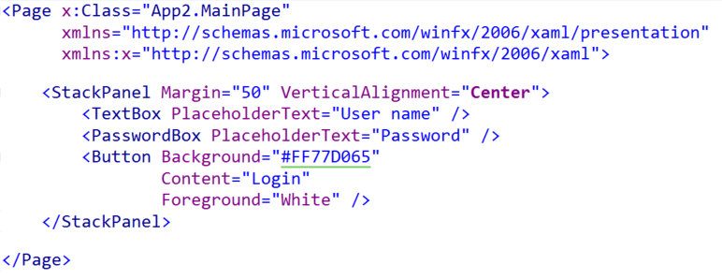
Microsoft XAML vs. MAUI
.NET MAUI conforms to the XAML 2021 specification; it differs from Microsoft XAML mainly in the controls and layout containers. However, it can be translated to it.
<ContentPage x:Class="MauiApp1.MainPage"
xmlns="http://schemas.microsoft.com/dotnet/2021/maui"
xmlns:x="http://schemas.microsoft.com/winfx/2009/xaml">
<StackLayout Margin="50" VerticalOptions="Center">
<Entry Placeholder="User Name" />
<Entry Placeholder="Password" IsPassword="True" />
<Button Text="Login" BackgroundColor="#FF77D065"
TextColor="White" />
</StackLayout>
</ContentPage>
Microsoft XAML (WPF & WinUI)
.NET MAUI
Notes:
If you've done any Microsoft UI development in the last few years, then it's likely that you've done some XAML already.
The XAML used in Xamarin.Forms follows the XAML 2009 specification published by Microsoft and includes almost all of the features described in that document – including things that aren't supported in Microsoft's implementation yet.
So the structure of XAML and how it works will be very familiar to the Microsoft XAML crowd, but the controls and elements you use to build up your screens will be a bit different.
[Next to show Microsoft]
As an example, here we have a simple page defined for a WinRT application which displays a TextBox, a password and a button organized vertically. The root container is a Page, and we use controls and layout containers that are specific to the WinRT world. This same structure could be created for WPF, but some of the controls and properties would be different – for example, in WPF the root element is most often a Window.
[Next to show Xam.Forms]
That same page in Xamarin.Forms would look something like this.
We use the same control for text entry in both cases, one is marked as taking a password, and the Button here has a Text property, not a Content property. The root element for most of our Xamarin.Forms pages will be ContentPage.
But you can see the similarity, and how the XAML definitions themselves are exactly the same. The key difference is the controls being used.

Slide 93
XAML namespaces
General XAML namespaces
Mapping custom types to XAML namespaces and prefixes
You can map custom types using following definition on the root element.
Prefix | URL | Description
None(default namespace) | http://schemas.microsoft.com/winfx/2006/xaml/presentation | For UI definition markup. For ex: Button, ListView, InkCanvas and more.
x | http://schemas.microsoft.com/winfx/2006/xaml | For support intrinsics. For ex: x:Array, x:Class, x:Key, x:Name and more.
d | http://schemas.microsoft.com/expression/blend/2008 | For design time. For ex: d:DesignWidth, d:DesignHeight and more.
mc | http://schemas.openxmlformats.org/markup-compatibility/2006 | For markup compatibility. For ex: Define mc:Ignorable=“d” in XAML then ignore “d” namespace at runtime.
xmlns:custom1="using:CustomClasses"
Notes:
If using XAML as UI markup language, then the root namespace is first line of the table. In this namespace is declared a lot of UI controls like as Page, Button, CheckBox and more.
“x” namespace is declared many intrinsics.
“d” namespace is namespace for design time. For example, d:DesithWidth defines the width of control in designer.
“mc” namespace is for markup compatibility.

Slide 94
“x” namespace
x:Class
Mapping XAML and code behind class.
MainPage.xaml
<Page x:Class="XamlDemo.Views.MainPage"
xmlns="http://schemas.microsoft.com/winfx/2006/xaml/presentation"
xmlns:x="http://schemas.microsoft.com/winfx/2006/xaml"
MainPage.xaml.cs
namespace XamlDemo.Views
{
public sealed partial class MainPage : Page
{
Notes:
A x:Class attribute map a code behind class. A code behind class is written custom logic for UI layer. For example, event handler logic, status management logic and more.

Slide 95
“x” namespace
x:Name
Uniquely identifies object elements so that you can leverage them in code behind
XAML
Code behind
<Page x:Class="XamlDemo.Views.MainPage"
xmlns="http://schemas.microsoft.com/winfx/2006/xaml/presentation"
xmlns:x="http://schemas.microsoft.com/winfx/2006/xaml"
xmlns:d="http://schemas.microsoft.com/expression/blend/2008"
xmlns:mc="http://schemas.openxmlformats.org/markup-compatibility/2006"
mc:Ignorable="d"
Background="{ThemeResource ApplicationPageBackgroundThemeBrush}">
<Grid>
<Button x:Name="button"
Content="Hello" />
</Grid>
</Page>
public MainPage()
{
this.InitializeComponent();
button.Content = "Sample";
}
Notes:
A x:Name attribute defines a variable for the control in the code behind class. Define the x:Name attribute then you can use the control in the code behind class using the name that is defined the x:Name attribute.

Slide 96
“x” namespace
x:Key
Uniquely identifies elements that are created and referenced in a XAML-defined dictionary; for example, in a WPF ResourceDictionary
<object x:Key="stringKeyValue".../>
-or-
<object x:Key="{markupExtensionUsage}".../>
in WPF
<object.Resources>
<object x:Key="stringKeyValue".../>
</object.Resources>
-or-
<object.Resources>
<object x:Key="{markupExtensionUsage}".../>
</object.Resources>

Slide 97
“x” namespace
x:Static
References any static by-value code entity that is defined in a Common Language Specification (CLS)–compliant way. The static property that is referenced can be used to provide the value of a property in XAML.
Object element syntax.
<x:Static Member="prefix:typeName.staticMemberName" ... />
Attribute syntax with explicit Member property for initialization string.
<object property="{x:Static Member=prefix:typeName.staticMemberName}" ... />

Slide 98
“x” namespace
Primitive types
You can define the value of primitive types using “x” namespace. See below:
Null
If you want to use the null value, then you can use the “x:Null” tag or the “x:Null” markup extension.
<x:String>Item1</x:String>
<x:Int32>100</x:Int32>
<x:Double>3.14</x:Double>
<x:Boolean>true</x:Boolean>
<x:Null />
SomeProperty="{x:Null}"
Notes:
In “x” namespace, define a lot of primitive types like String, Int32, Double, Boolean and more.
And "x:Null" tag and "x:Null" markup extension is defined for null value.

Slide 99
Dependency properties
Notes:
explain resources feature

Slide 100
What is a dependency property?
A dependency property is a specialized type of property.
The property’s value is ...
tracked
influenced by a dedicated property system that is part of the Windows Runtime.
A dependency property can be used with a set of specific features, like:
Data binding
Styles
Storyboard animations
“PropertyChanged” behavior
Default value from property metadata
Notes:
A dependency property is a specialized type of property. Specifically it's a property where the property's value is tracked and influenced by a dedicated property system that is part of the Windows Runtime.
The purpose of dependency properties is to provide a systemic way to compute the value of a property based on other inputs (other properties, events and states that occur within your app while it runs). These other inputs might include:
External input such as user preference
Just-in-time property determination mechanisms such as data binding, animations and storyboards
Multiple-use templating patterns such as resources and styles
Values known through parent-child relationships with other elements in the object tree
A dependency property represents or supports a specific feature of the programming model for defining a Windows Runtime app with XAML for UI and C#, Microsoft Visual Basic or Visual C++ component extensions (C++/CX) for code. These features include:
Data binding
Styles
Storyboarded animations
"PropertyChanged" behavior; a dependency property can be implemented to provide callbacks that can propagate changes to other dependency properties
Using a default value that comes from property metadata
General property system utility such as ClearValue and metadata lookup

Slide 101
Why Do We need Dependency Property
Dependency property gives you all kinds of benefits when you use it in your application. Dependency Property can used over a CLR property in the following scenarios −
If you want to set the style
If you want data binding
If you want to set with a resource (a static or a dynamic resource)
If you want to support animation
Basically, Dependency Properties offer a lot of functionalities that you won’t get by using a CLR property.

Slide 102
Dependency Property vs Regular Property
The main difference between dependency properties and other CLR properties are listed below −
CLR properties can directly read/write from the private member of a class by using getter and setter. In contrast, dependency properties are not stored in local object.
Dependency properties are stored in a dictionary of key/value pairs which is provided by the DependencyObject class. It also saves a lot of memory because it stores the property when changed. It can be bound in XAML as well.

Slide 103
How to define a dependency property?
Inherit from the DependencyObject class.
Define a static field of DependencyProperty’s type
Define property wrapper
public class MyClass : DependencyObject
{
public static readonly DependencyProperty MyPropertyProperty =
DependencyProperty.Register("MyProperty", // property name
typeof(string), // property type
typeof(MyClass), // property owner type
new PropertyMetadata("initial value"));// metadata
// property wrapper
public string MyProperty
{
get { return (string)GetValue(MyPropertyProperty); }
set { SetValue(MyPropertyProperty, value); }
}
}
Notes:
Dependency properties have to be defined in a class that is inherited a DepenencyObject class.
The first, define a static field using Register static method of DependencyProperty class, then define the property wrapper using a GetValue method and a SetValue mthods.

Slide 104
Attached properties
Notes:
explain resources feature

Slide 105
What is an attached property?
You can add new custom properties to an existing object
You can define them using the same syntax as dependency properties.
public class MyClass : DependencyObject
{
public static readonly DependencyProperty MyPropertyProperty =
DependencyProperty.RegisterAttached( // use RegisterAttached method "MyProperty", // property name
typeof(string), // property type
typeof(MyClass), // property owner type
new PropertyMetadata("initial value")); // initial value
// wrapper
public static string GetMyProperty(DependencyObject obj)
{
return (string)obj.GetValue(MyPropertyProperty);
}
public static void SetMyProperty(DependencyObject obj, string value)
{
obj.SetValue(MyPropertyProperty, value);
}
}
Notes:
An attached property is a XAML concept. Attached properties enable additional property/value pairs to be set on an object, but the properties are not part of the original object definition. Attached properties are typically defined as a specialized form of dependency property that doesn't have a conventional property wrapper in the owner type's object model.
Define your attached property as a dependency property by declaring a public static readonly property of type DependencyProperty. You define this property by using the return value of the RegisterAttached method. The property name must match the attached property name you specify as the RegisterAttached name parameter, with the string "Property" added to the end. This is the established convention for naming the identifiers of dependency properties in relation to the properties that they represent.
The main area where defining a custom attached property differs from a custom dependency property is in how you define the accessors or wrappers. Instead of the using the wrapper technique described in Custom dependency properties, you must also provide static GetPropertyName and SetPropertyName methods as accessors for the attached property. The accessors are used mostly by the XAML parser, although any other caller can also use them to set values in non-XAML scenarios.

Slide 106
Demo:
XAML Basics

Slide 107
Common UI Controls and Layouts

Slide 108
Controls
The user experiences that are delivered by the application model are constructed controls. In WPF, control is an umbrella term that applies to a category of WPF classes that have the following characteristics:
Hosted in either a window or a page.
Have a user interface.
Implement some behavior.

Slide 109
Built-In Controls
Buttons: Button and RepeatButton.
Data Display: DataGrid, ListView, and TreeView.
Date Display and Selection: Calendar and DatePicker.
Dialog Boxes: OpenFileDialog, PrintDialog, and SaveFileDialog.
Digital Ink: InkCanvas and InkPresenter.
Documents: DocumentViewer, FlowDocumentPageViewer, FlowDocumentReader, FlowDocumentScrollViewer, and StickyNoteControl.
Input: TextBox, RichTextBox, and PasswordBox.
Layout: Border, BulletDecorator, Canvas, DockPanel, Expander, Grid, GridView, GridSplitter, GroupBox, Panel, ResizeGrip, Separator, ScrollBar, ScrollViewer, StackPanel, Thumb, Viewbox, VirtualizingStackPanel, Window, and WrapPanel.
Media: Image, MediaElement, and SoundPlayerAction.
Menus: ContextMenu, Menu, and ToolBar.
Navigation: Frame, Hyperlink, Page, NavigationWindow, and TabControl.
Selection: CheckBox, ComboBox, ListBox, RadioButton, and Slider.
User Information: AccessText, Label, Popup, ProgressBar, StatusBar, TextBlock, and ToolTip.

Slide 110
Layout Panels
Panel name | Description
Grid | Defines a flexible grid area that consists of columns and rows.
StackPanel | Arranges child elements into a single line that can be oriented horizontally or vertically.
Canvas | Defines an area within which you can explicitly position child elements by coordinates relative to the Canvas area.
DockPanel | Defines an area within which you can arrange child elements either horizontally or vertically, relative to each other.
WrapPanel | Positions child elements in sequential position from left to right, breaking content to the next line at the edge of the containing box. Subsequent ordering occurs sequentially from top to bottom or right to left, depending on the value of the Orientation property.
VirtualizingPanel | Provides a framework for Panel elements that virtualize their child data collection. This is an abstract class.

Slide 111
Grid
<Page xmlns="http://schemas.microsoft.com/winfx/2006/xaml/presentation" WindowTitle="Grid Sample">
<Grid VerticalAlignment="Top" HorizontalAlignment="Left" ShowGridLines="True" Width="250" Height="100">
<Grid.ColumnDefinitions>
<ColumnDefinition />
<ColumnDefinition />
<ColumnDefinition />
</Grid.ColumnDefinitions>
<Grid.RowDefinitions>
<RowDefinition />
<RowDefinition />
<RowDefinition />
<RowDefinition />
</Grid.RowDefinitions>
<TextBlock FontSize="20" FontWeight="Bold" Grid.ColumnSpan="3" Grid.Row="0">2005 Products Shipped</TextBlock>
<TextBlock FontSize="12" FontWeight="Bold" Grid.Row="1" Grid.Column="0">Quarter 1</TextBlock>
<TextBlock FontSize="12" FontWeight="Bold" Grid.Row="1" Grid.Column="1">Quarter 2</TextBlock>
<TextBlock FontSize="12" FontWeight="Bold" Grid.Row="1" Grid.Column="2">Quarter 3</TextBlock>
<TextBlock Grid.Row="2" Grid.Column="0">50000</TextBlock>
<TextBlock Grid.Row="2" Grid.Column="1">100000</TextBlock>
<TextBlock Grid.Row="2" Grid.Column="2">150000</TextBlock>
<TextBlock FontSize="16" FontWeight="Bold" Grid.ColumnSpan="3" Grid.Row="3">Total Units: 300000</TextBlock>
</Grid>
</Page>

Slide 112
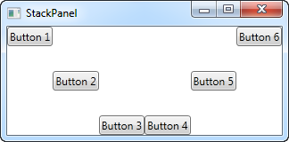
StackPanel
<StackPanel Orientation="Vertical">
<TextBlock Text="Text one" />
<TextBlock Text="Text two" />
<Button Content="Click me" />
</StackPanel>
<StackPanel Orientation="Horizontal">
<Button VerticalAlignment="Top">Button 1</Button>
<Button VerticalAlignment="Center">Button 2</Button>
<Button VerticalAlignment="Bottom">Button 3</Button>
<Button VerticalAlignment="Bottom">Button 4</Button>
<Button VerticalAlignment="Center">Button 5</Button>
<Button VerticalAlignment="Top">Button 6</Button>
</StackPanel>

Slide 113
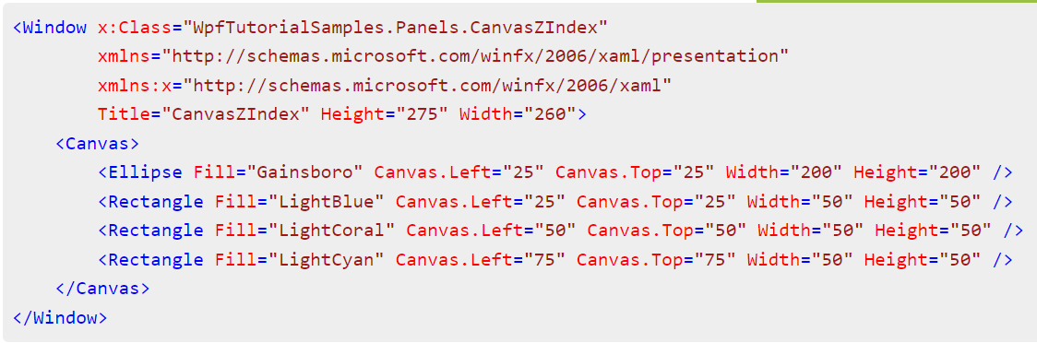
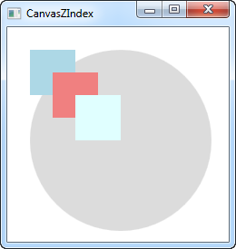
Canvas

Slide 114
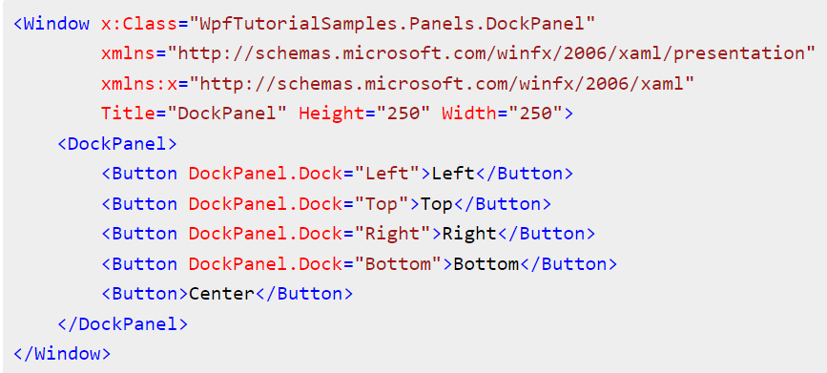
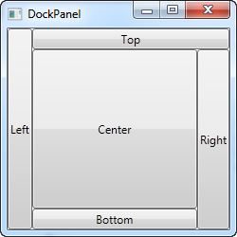
DockPanel

Slide 115
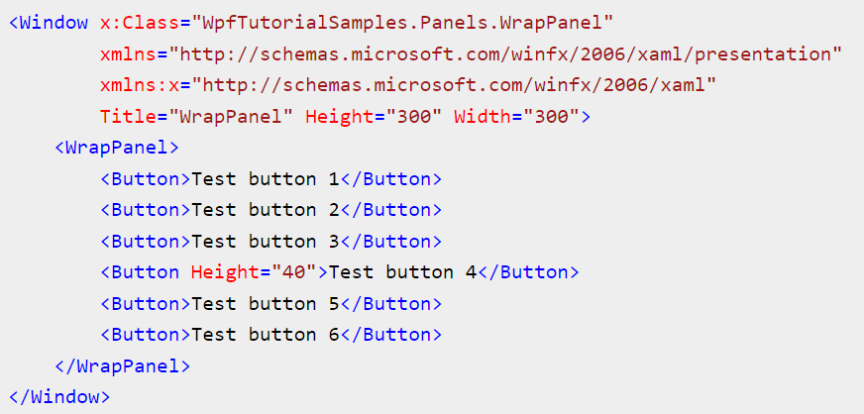
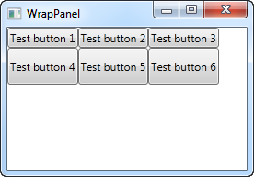
WrapPanel

Slide 116
Demo:
XAML Controls and Layouts

Slide 117
Basic Event Handling

Slide 118
Behavior or Functionality
The main behavior of an application is to implement the functionality that responds to user interactions. For example clicking a menu or button, and calling business logic and data access logic in response. In WPF, this behavior is implemented in code that is associated with markup. This type of code is known as code-behind.

Slide 119
XAML
<Window
xmlns="http://schemas.microsoft.com/winfx/2006/xaml/presentation"
xmlns:x="http://schemas.microsoft.com/winfx/2006/xaml"
x:Class="SDKSample.AWindow"
Title="Window with Button"
Width="250" Height="100">
<!-- Add button to window -->
<Button Name="button" Click="button_Click">Click Me!</Button>
</Window>

Slide 120
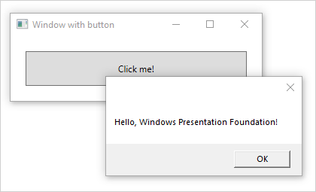
Code-Behind
using System.Windows;
namespace SDKSample
{
public partial class AWindow : Window
{
public AWindow()
{
// InitializeComponent call is required to merge the UI
// that is defined in markup with this class, including
// setting properties and registering event handlers
InitializeComponent();
}
void button_Click(object sender, RoutedEventArgs e)
{
// Show message box when button is clicked.
MessageBox.Show("Hello, Windows Presentation Foundation!");
}
}
}

Slide 121
Demo:
Basic Event Handling

Slide 122
Lab 1 – Create WPF First App
Create a new WPF app
Add controls to a form
Handle control events to provide app functionality
Run the app
https://aka.ms/AAj4946
https://learn.microsoft.com/en-us/dotnet/desktop/wpf/get-started/create-app-visual-studio

